Slide 1
ADE App User Guide
Czarina Bonrostro
Intern 2025 – Data Automation

Slide 2
How to Use

Slide 3
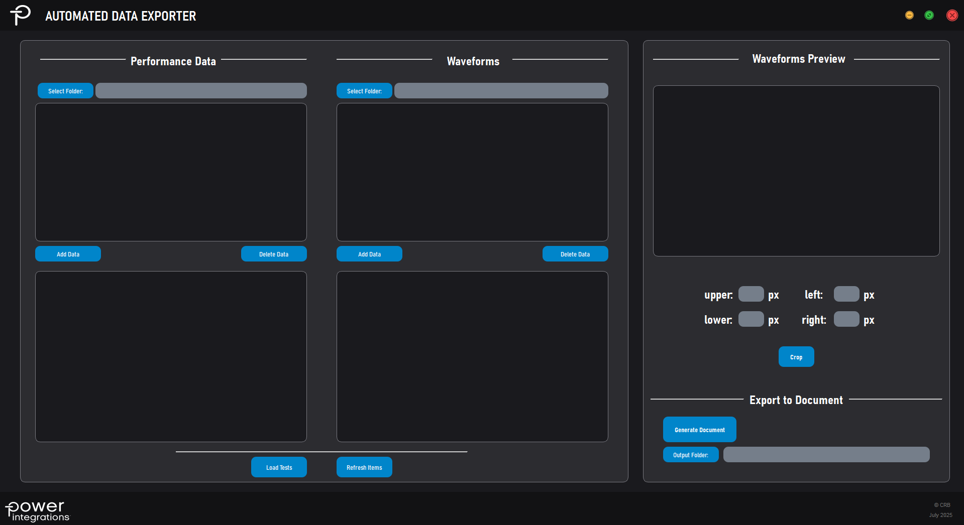
Start-up
Select folders containing your performance and waveform data
Figure 1: ADE Start-up

Slide 4
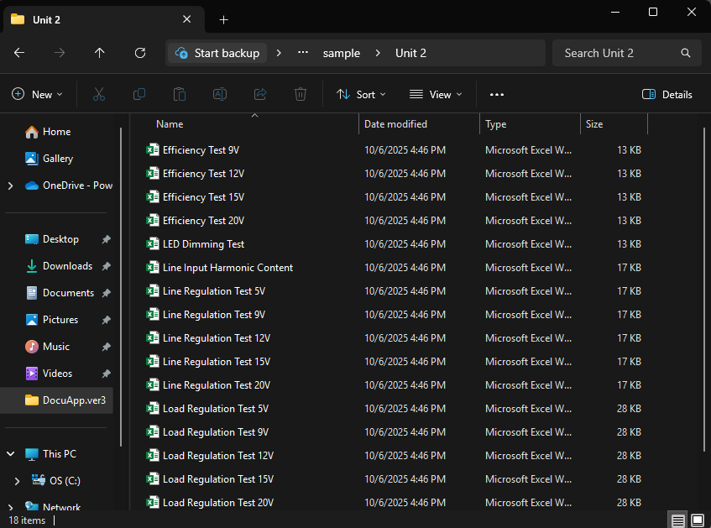
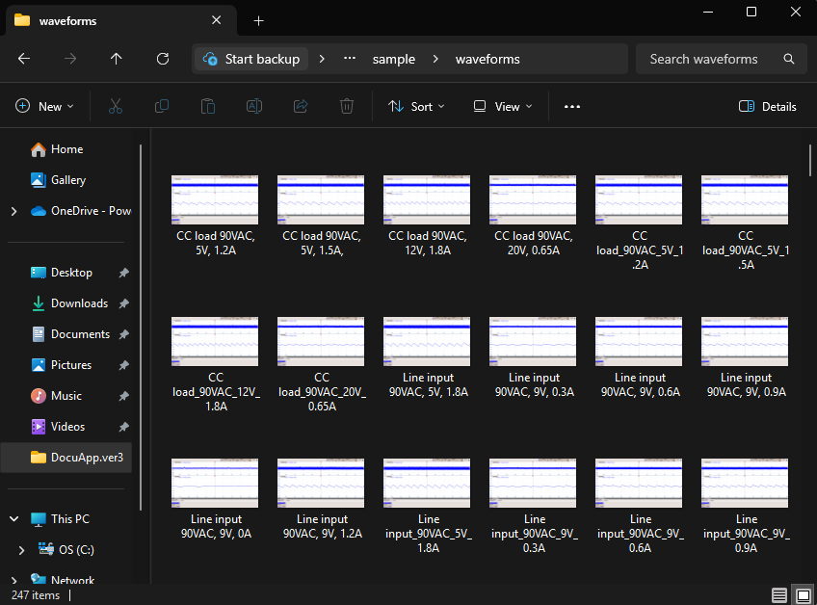

Folder and Excel Formats
Performance Data Folder
Accepted file: Excel
File name: <Test Name>.xlsx
E.g. Efficiency Test 12V
Charts in excel files should be in a chartsheet (not worksheet) with name format <Charts_[par1vpar2]_val1V_val2A>, otherwise ADE would not be able to detect it (Figure 4)
Note: Chartsheet names should follow the format to generate accurate caption when exported to DER document [FOR IMPROVEMENT]
For now, automated captions are for chartsheets with name “lnveff“, “ldveff”, “loadvripple”, “linereg”, “loadreg”
Sample captions for these charts is "Line vs Efficiency, {volts}, {current}“ for the “lnveff”
Waveforms Folder
Accepted file: jpeg, png
File name: <Test name val1, val2, val3>.xlsx
E.g. CC load 90VAC, 5V, 1.2A
Note: File name should follow the format to generate accurate caption when exported to DER document
Sample caption is CC load 90 VAC, 5 V, 1.2 A
Figure 2: Sample performance test folder contents
Figure 3: Sample waveforms folder contents
Figure 4: Sample chartsheet name formats

Slide 5
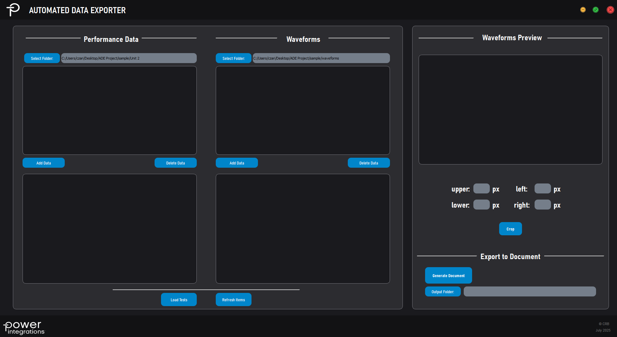
Update List
After selecting your folders, click the “Load Tests” button below.
Expect that the lists will update automatically
Figure 5: ADE Load Test

Slide 6
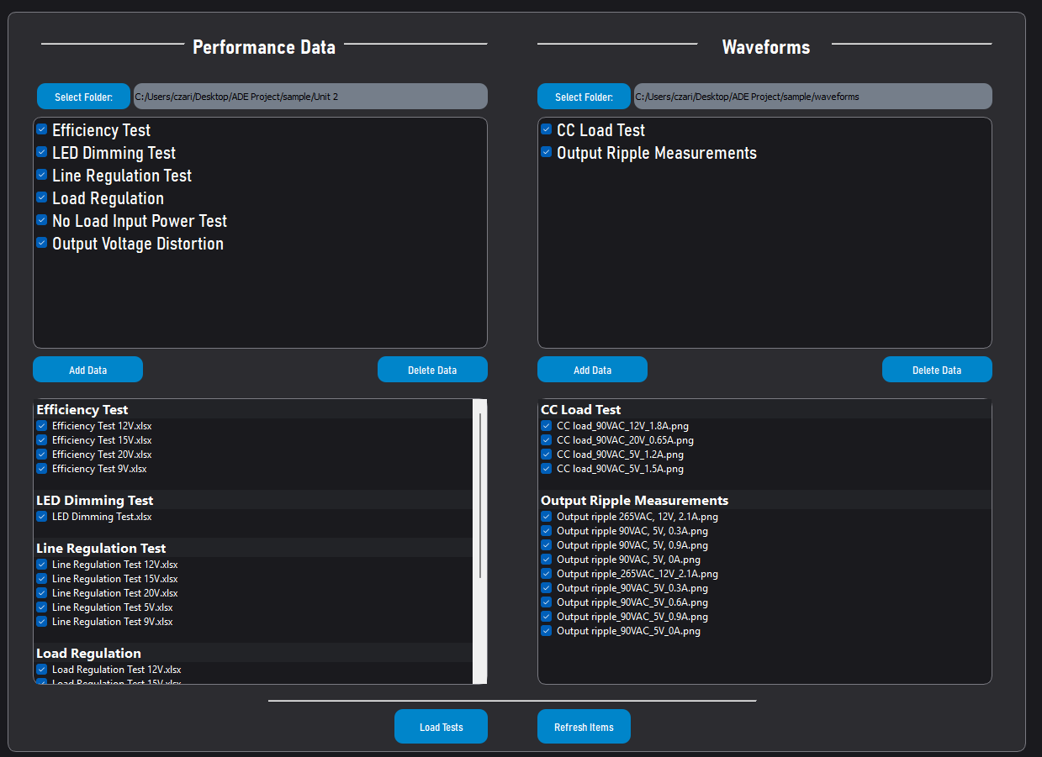
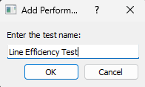
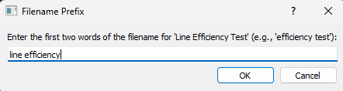
Add and Delete Tests
The lists would show the default tests saved on the application
You may add additional default tests by clicking the “Add Data” buttons
You will be asked to input the name of the new test that would reflect on the list (figure 5)
The second input will ask on the prefix (first two words) of the file name ADE would use to search on the selected folder (figure 6)
You may also delete default tests that are not necessary by clicking the “Delete Data”
Figure 5: ADE Add test first input
Figure 7: ADE Add test second input
Figure 6: ADE Load Test

Slide 7
Select Files
You may manually select the files you want to include in the DER document by unticking the checkboxes
You may rearrange the lists based on your preference (this arrangement would also reflect on the DER document) by dragging items to desired placements
If the performance data and waveforms data lists arrangements are modified, click the “Refresh Items” to update the list items
Figure 8: Selecting and rearranging list items

Slide 8
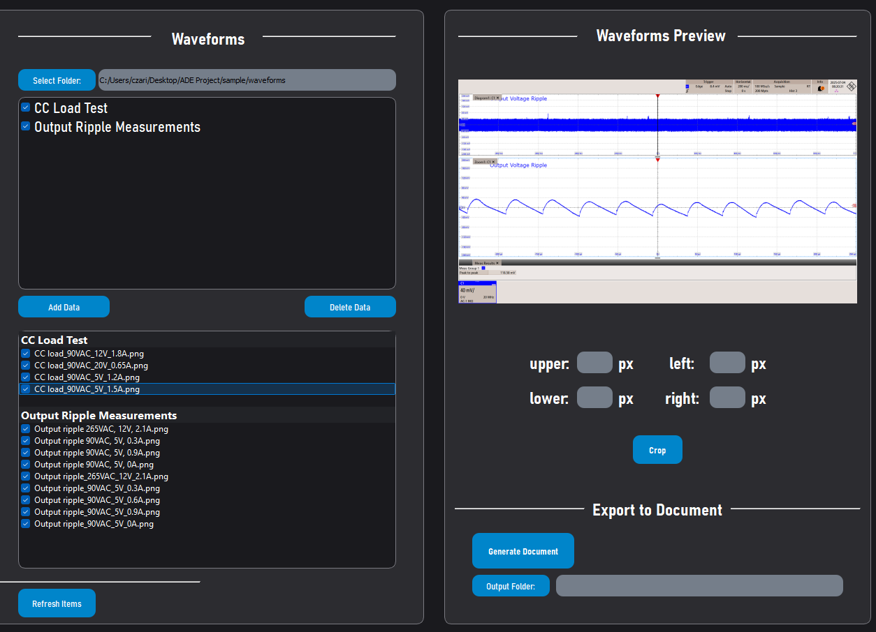
Cropping Waveforms
A preview of the selected waveform from the test items can be seen on the waveforms preview panel
You can also crop these waveforms by entering how many pixels you want to crop from the upper, lower, left and right of the images.
The set values on the boxes would be used in all waveforms when exported to DER document
Figure 9: Waveform cropping

Slide 9
Generate Document
Select an output folder for your document by clicking the “Output Folder” button
If user did not input any path for output folder, default would be desktop
By clicking “Generate Document” button, the ADE will extract the charts from selected test items, then proceeds to creating DER document draft
While extracting charts and images from the folders, ADE will notify user whether a file does not have a chart – this would prompt the ADE to extract tables instead
A notification would inform user that the extraction was successful and the document was created
Figure 10:Waveforms preview and export document panel

Slide 10
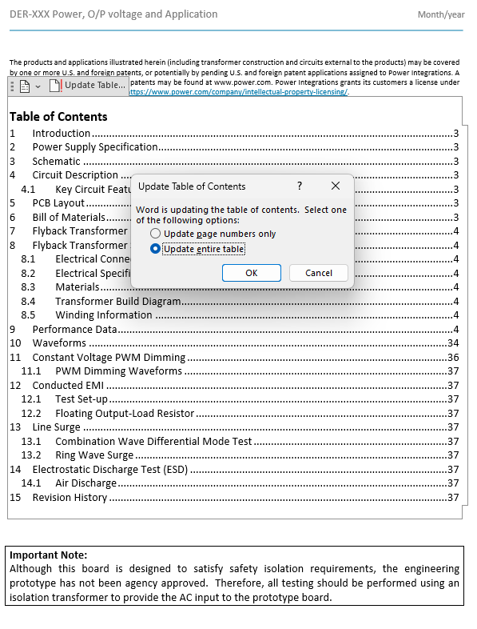
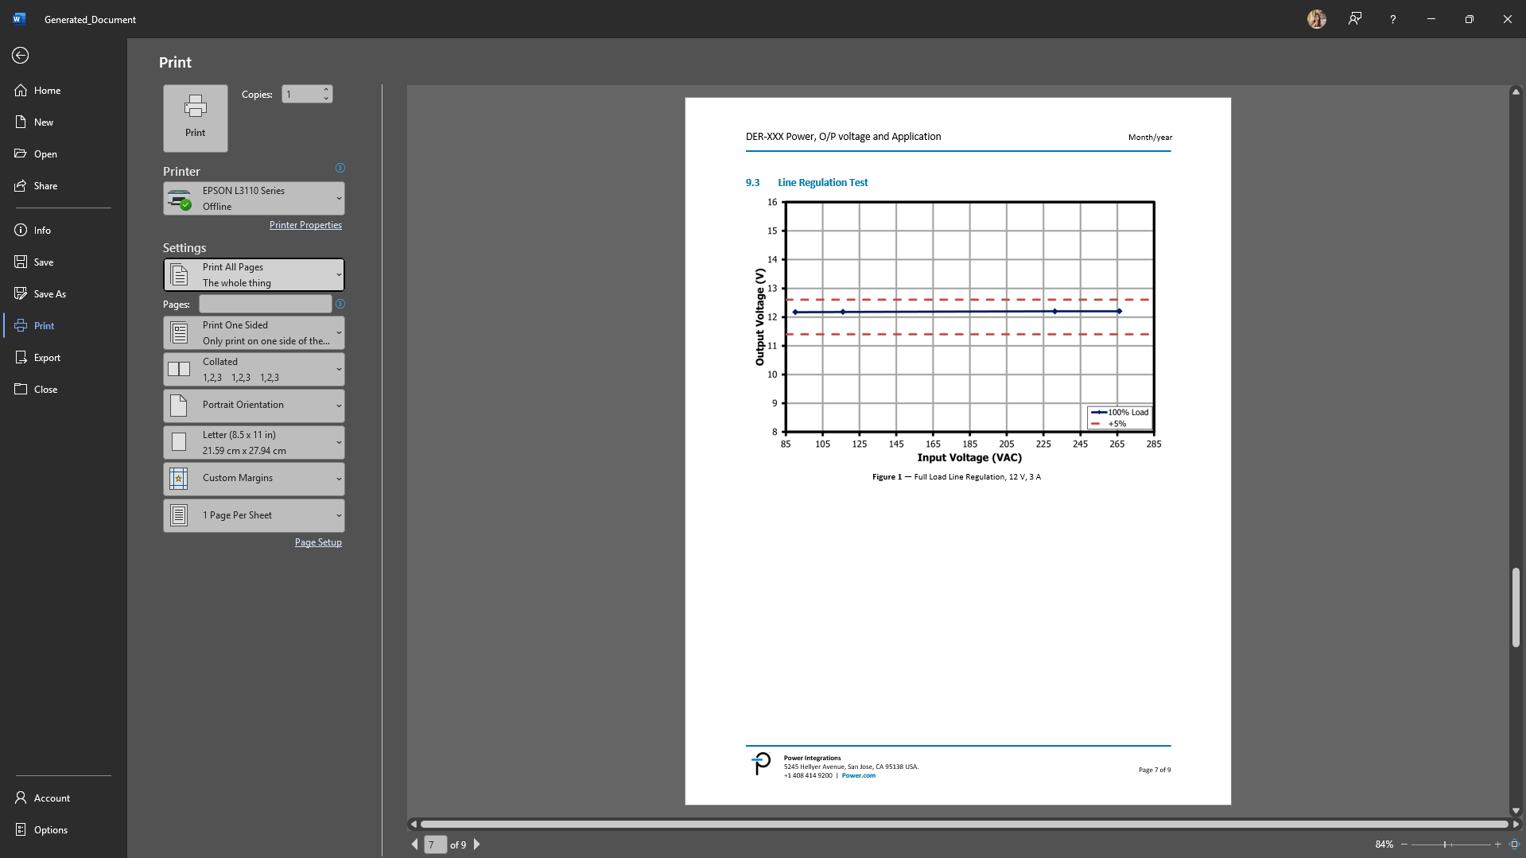
Output DER
The output DER would need to manually update the table field to reflect the new sections added by ADE
The output DER would initially have blank figure numbers and table numbers
To update all figure numbers and table numbers simultaneously, go to print preview and exit the preview right after
Figure 12: Updating table of contents
Figure 11: Word document print preview

Slide 11
END

